Slide 1

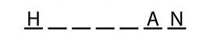
Hangman Parallel Evolution

Slide 2
Problem Statement
The objective of this project is to explore and implement parallelization techniques using high-performance computing to evolve and enhance word-guessing strategies in the game of Hangman.
Hangman is a popular word-guessing game where players attempt to guess a hidden word letter by letter within a limited number of attempts.
Traditionally, Hangman strategies rely on heuristic methods and sequential execution, which leads to inefficiencies in performance.
The aim of the project is to implement parallel evolution and improve the gameplay experience.

Slide 3
Method 1 – Multiple games
This code analyzes the performance of running multiple Hangman game simulations in parallel using multiprocessing.
It starts by setting up a list of words for the Hangman game and defines functions to simulate a single game and to run multiple games concurrently.
The main part of the code iterates through different combinations of the number of games and processing elements to measure the speedup and parallel efficiency.
It then generates graphs to visualize the relationship between the number of games and these metrics.
The bell-shaped curve typically observed in speedup graphs indicates the optimal point where the speedup reaches its maximum value before plateauing or diminishing due to overheads associated with parallelization.
Lacks a detailed emphasis on the efficient execution of a large number of Hangman game simulations using multiprocessing.

Slide 4
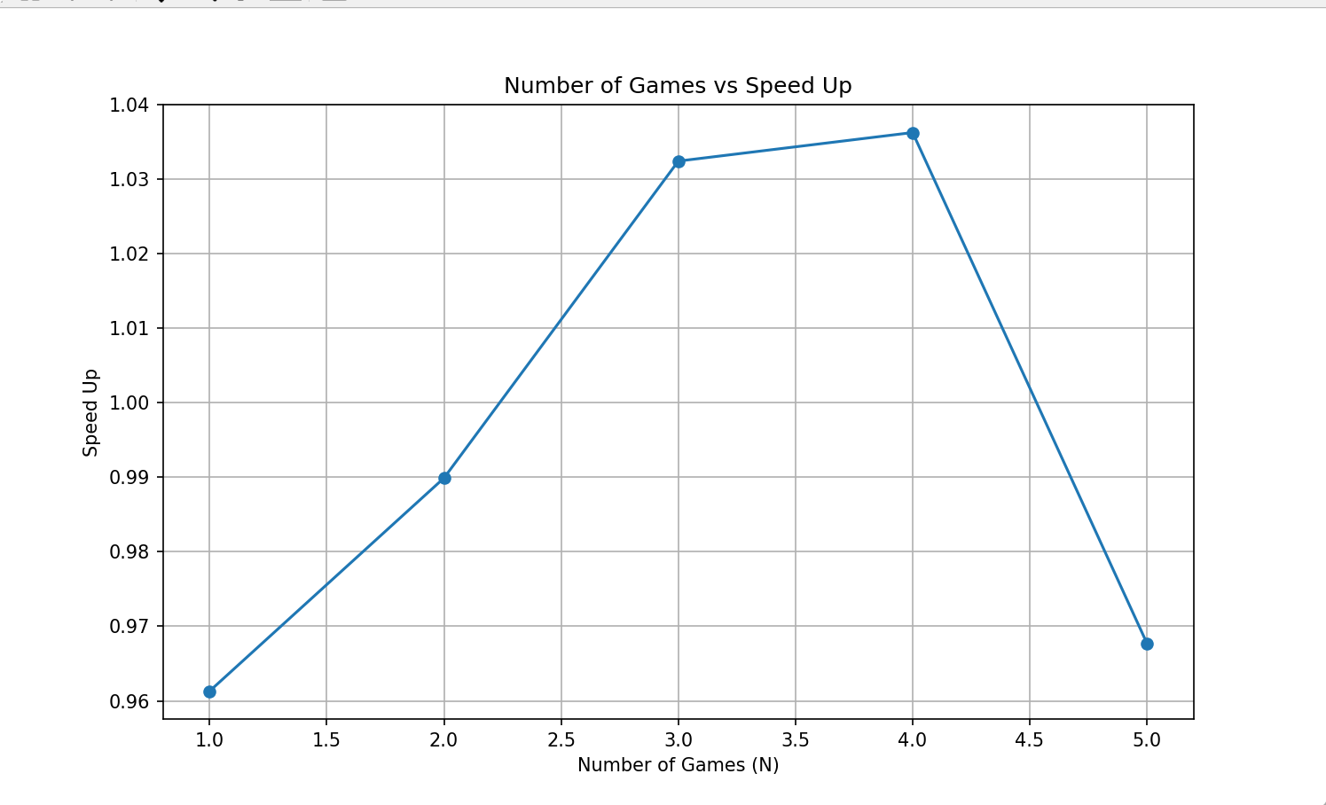
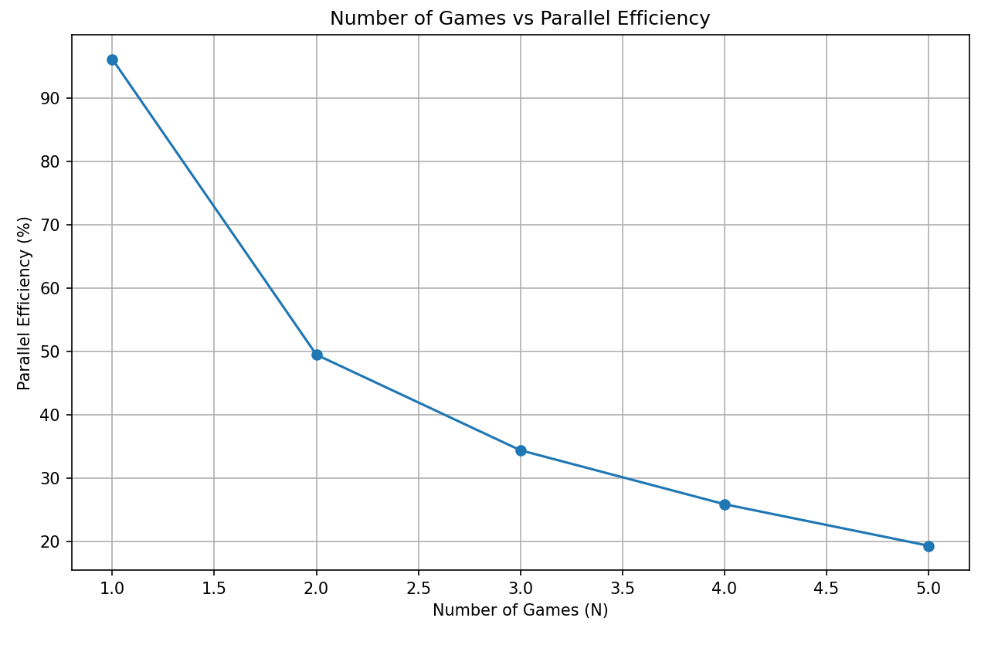
Performance Metrics

Slide 5
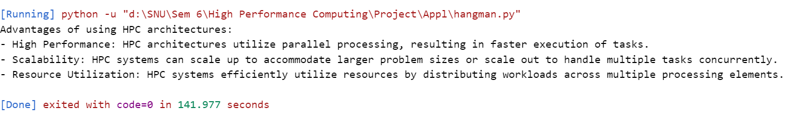
Performance Metrics

Slide 6
Method 1 - An emphasis on Practical Execution
This method demonstrates parallel processing for accelerating Hangman game simulations. It divides a large word list into chunks, distributing them across multiple processes for simultaneous simulation.
By utilizing multiprocessing, it significantly reduces the time required to complete a vast number of game iterations.
Initially, it partitions an extensive word repository into smaller subsets, distributing them among multiple computing processes.
This approach enables simultaneous execution of game simulations, leveraging the computational power of modern multicore systems.
It capitalizes on the concurrent execution of tasks, effectively harnessing the available processing resources to accelerate the simulation process.
Its emphasis lies on efficiently completing the simulations in a timely manner by leveraging parallel processing.

Slide 7
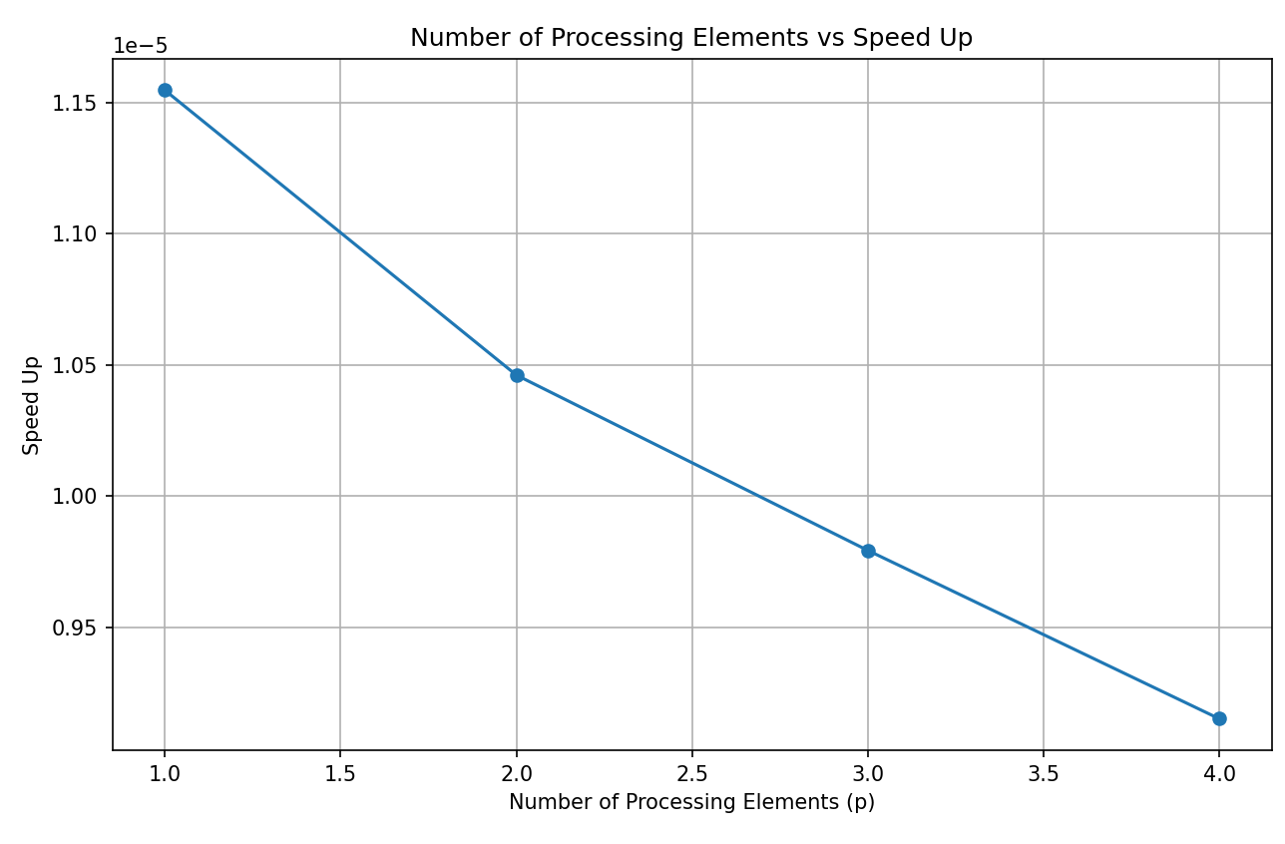
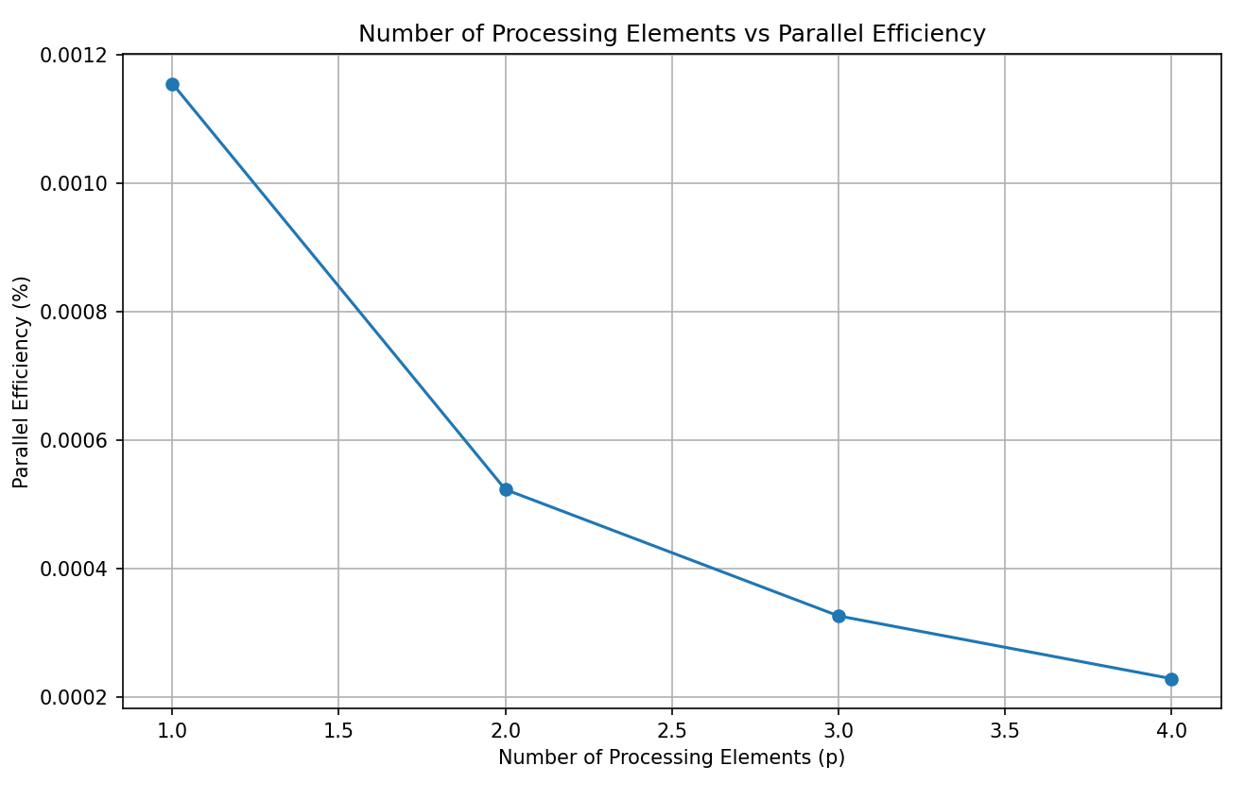
Performance Metrics

Slide 8
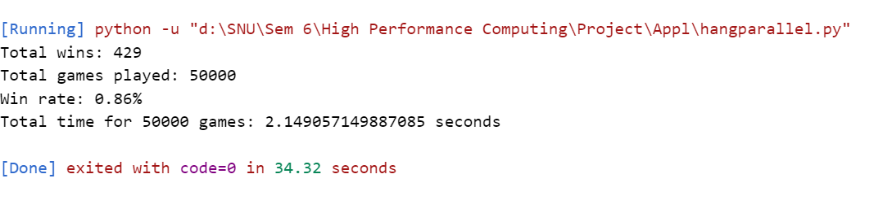
Performance Metrics

Slide 9
Method 2 – Letter based
This method utilizes multiprocessing to analyze a collection of words efficiently, selecting the most common letter among valid words.
It starts by defining a function to verify if a word consists entirely of lowercase letters.
The main function divides the word list into chunks and distributes them among multiple processes for parallel analysis, determining the most common letter among valid words within each chunk.
It focuses on analyzing a collection of words to determine the most common letter among valid words, utilizing multiprocessing for parallel processing and employs multiprocessing to distribute the analysis of word chunks among multiple processes, enhancing the efficiency of determining the most common letter..

Slide 10
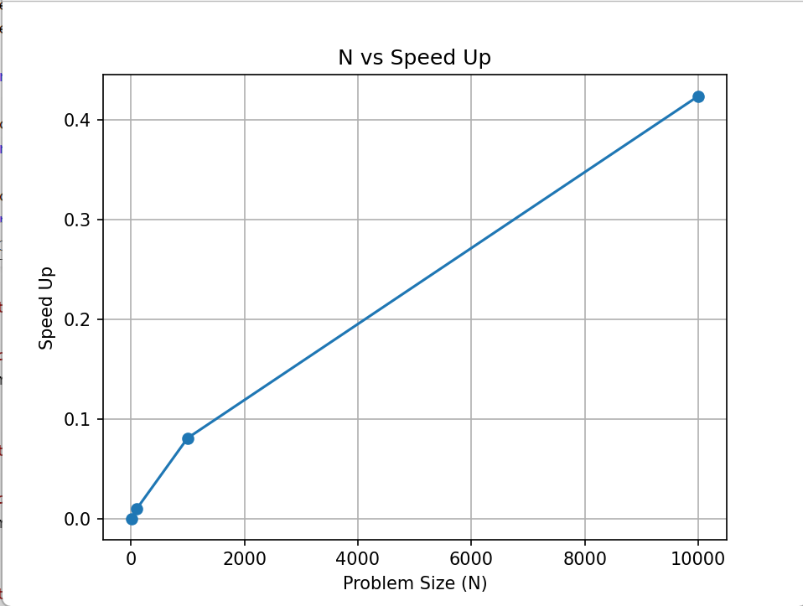
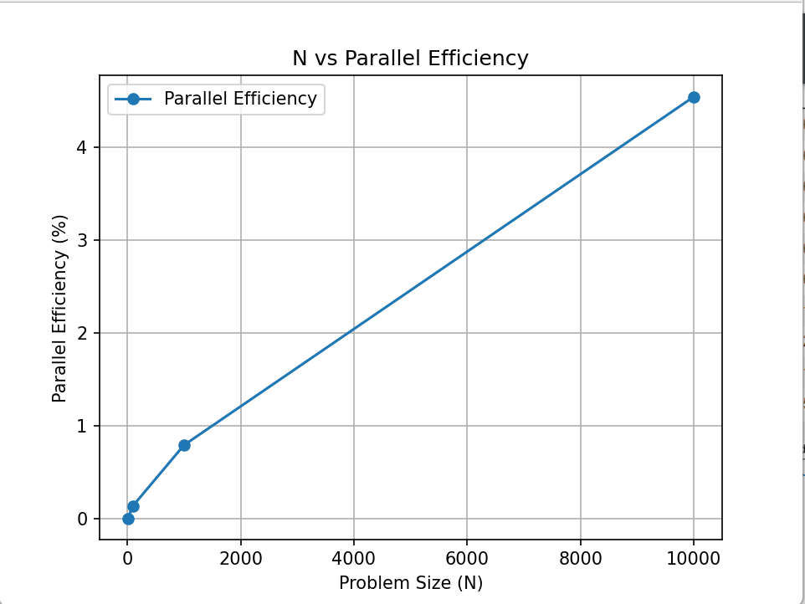
Performance Metrics

Slide 11
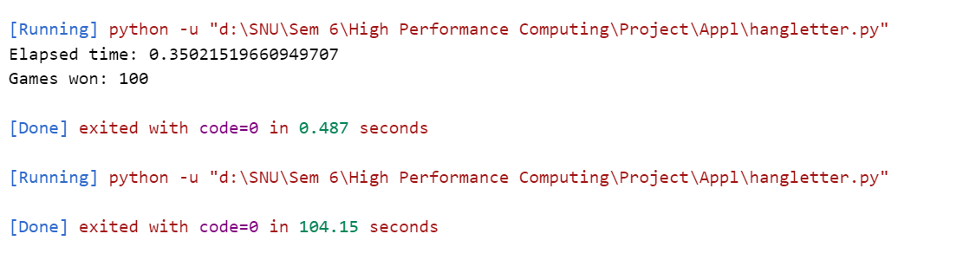
Performance Metrics

Slide 12
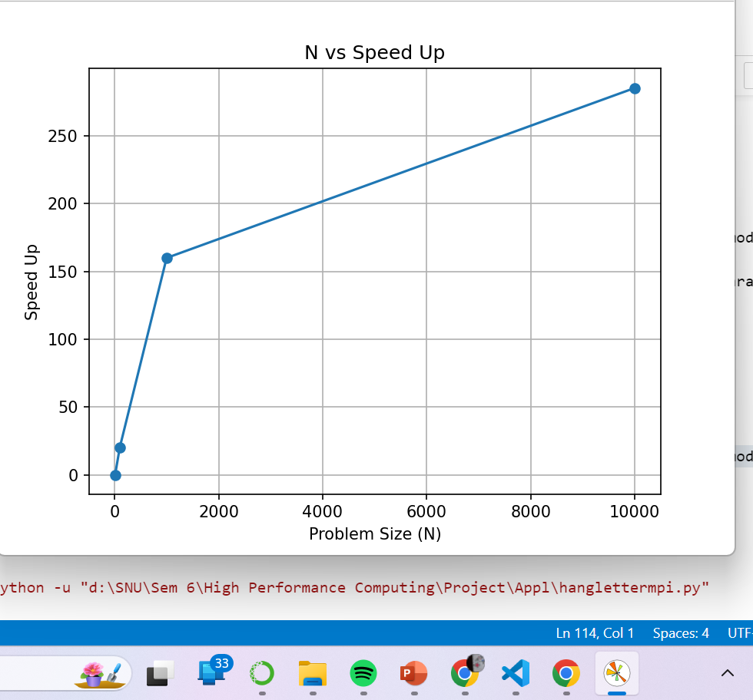
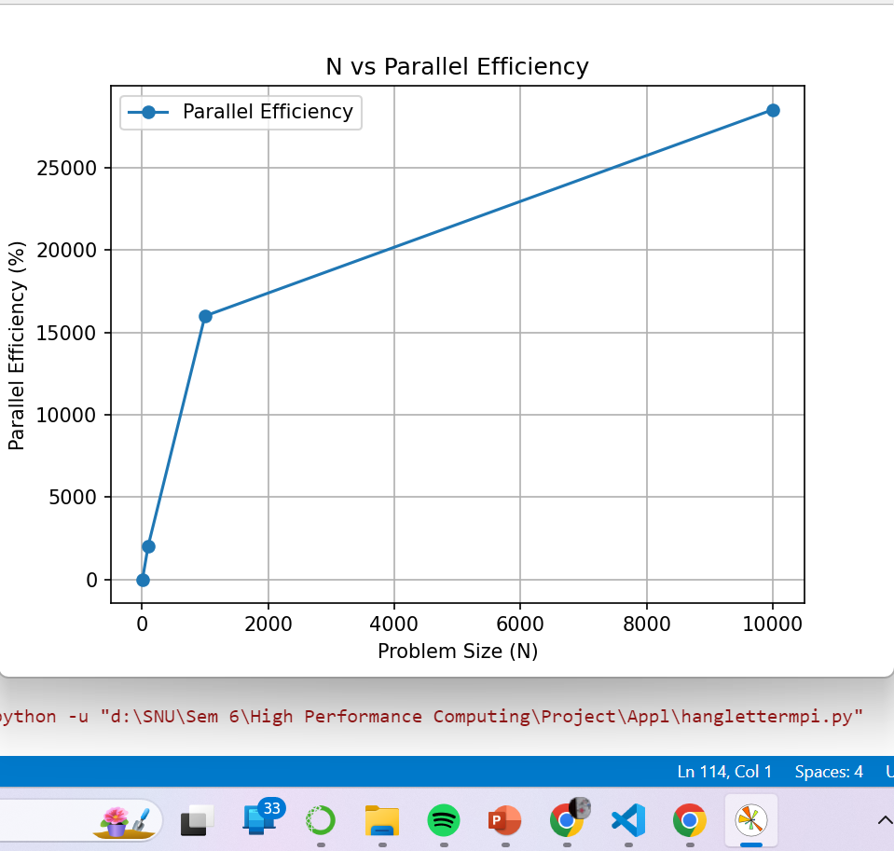
Performance Metrics – Using MPI

Slide 13
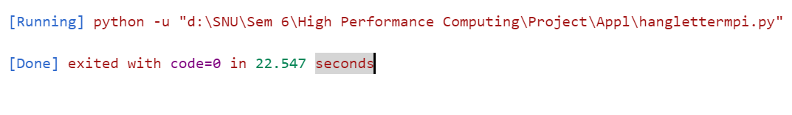
Performance Metrics

Slide 14
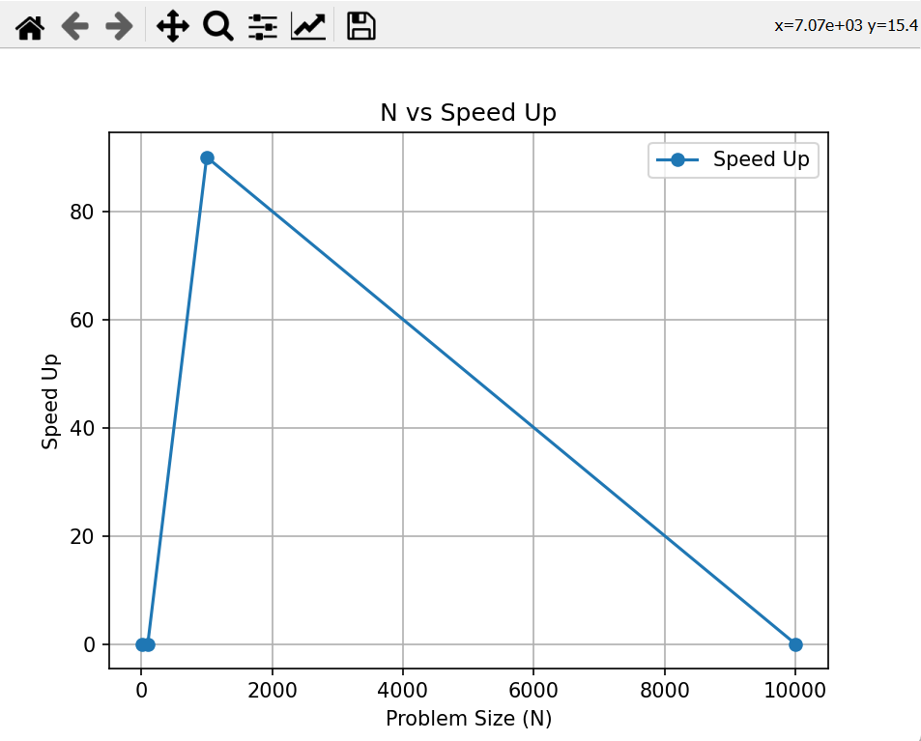
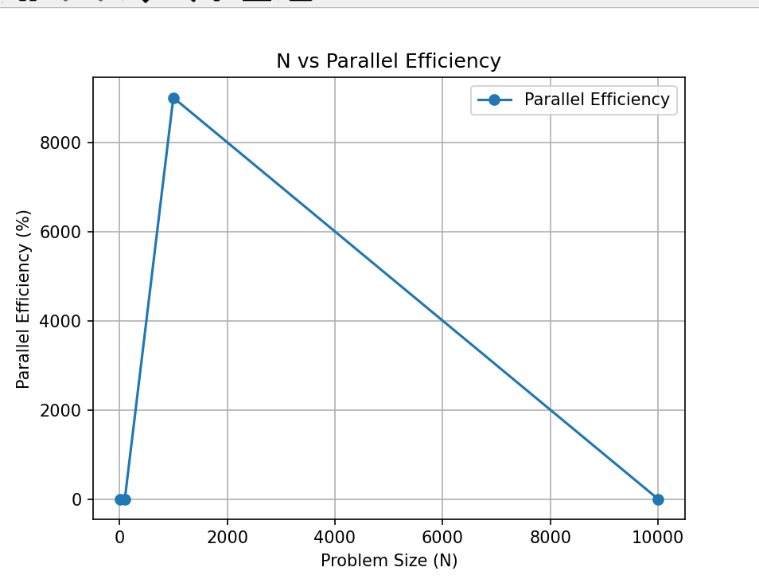
Performance Metrics – Using MPI

Slide 15
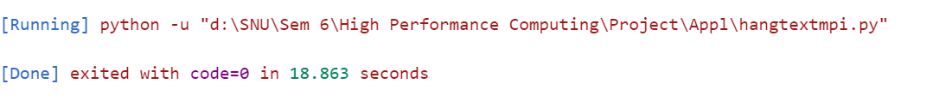
Performance Metrics

